Slide 1
Predicting the success of a mobile app
DATA 621: Group 3

Slide 2
Introduction
In 2014 Dong Nguyen revealed that his game Flappy Bird was earning an average of $50,000 a day from in-app ads. At that time, Flappy Bird, an addictive and tough game, had been number 1 on the Apple App Store and Google Play Store for almost a month and was gaining more downloads daily. In fact, by January 2014 the app had 50 million downloads, 68,000 reviews, and held the number 1 spot for most downloaded free game in 53 countries.
With millions of apps available for download today, many app developers could only dream of the success that Flappy Bird saw. So, did Nguyen know how to make an app so successful, and is there any way for us use app statistics to predict the success of an app? Kaggle has a couple of datasets with mobile application statistics that can possibly help us answer these questions. The datasets contain information around Apple apps on the App Store and Google apps on the Play Store; information centered around ratings, app size, installs, and price. Our idea is to take these datasets to see if we can use several regression methods to predict the successfulness of an app.

Slide 3
Methodology

Slide 4
APPLE STORE Dataset Features
Track Name
App Name
Size Bytes
Size (in Bytes)
Currency
Price
Rating Count Tot
User Rating counts (for all version)
Rating Count Ver
User Rating counts (for current version)
User Rating
Average User Rating value (for all version)
User Rating Ver
Average User Rating value (for current version)
Lang.num
Number of supported languages
Vpp_lic
Vpp Device Based Licensing Enabled
Ver
Latest version code
Cont Rating
Content Rating
Prime Genre
Primary Genre
Sup Devices.num
Number of supporting devices
ipadSc urls.num
Number of screenshots showed for display

Slide 5
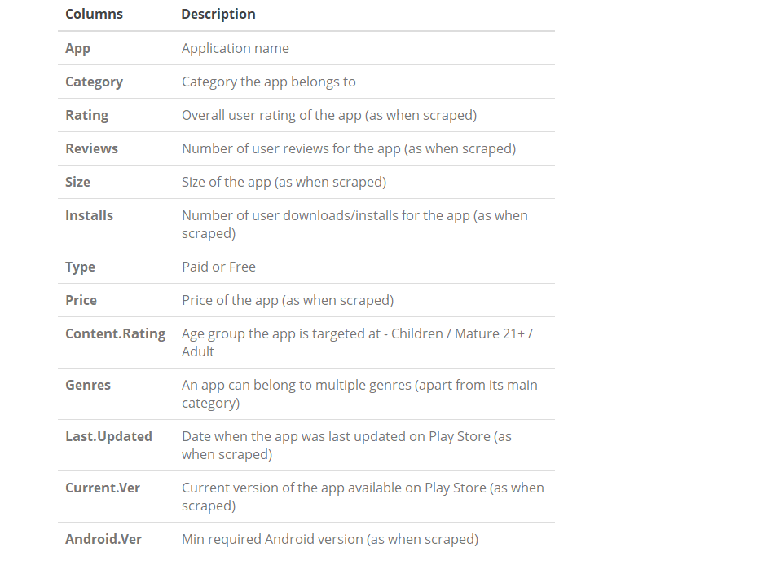

Google play STORE Dataset Features

Slide 6
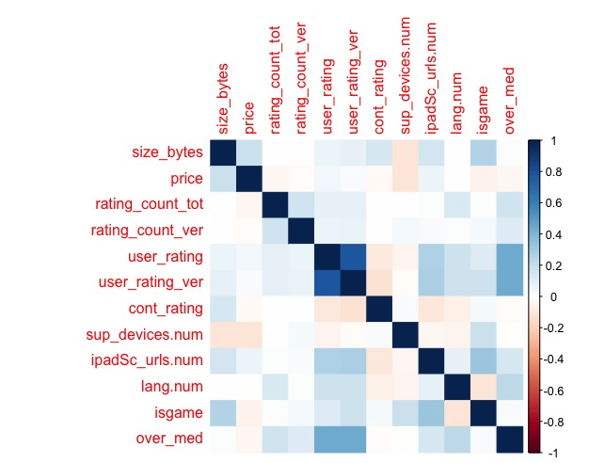
Apple data correlation

Slide 7
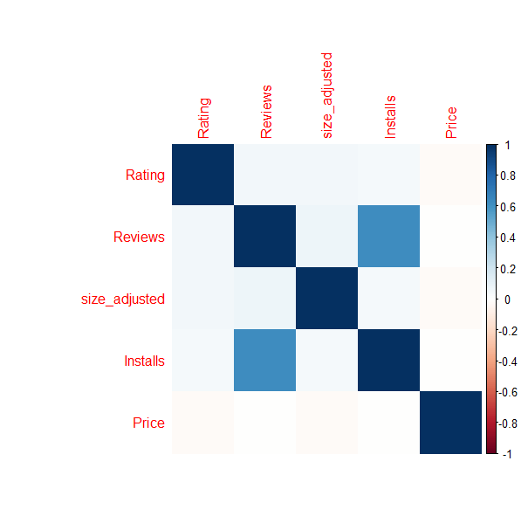
google data correlation

Slide 8
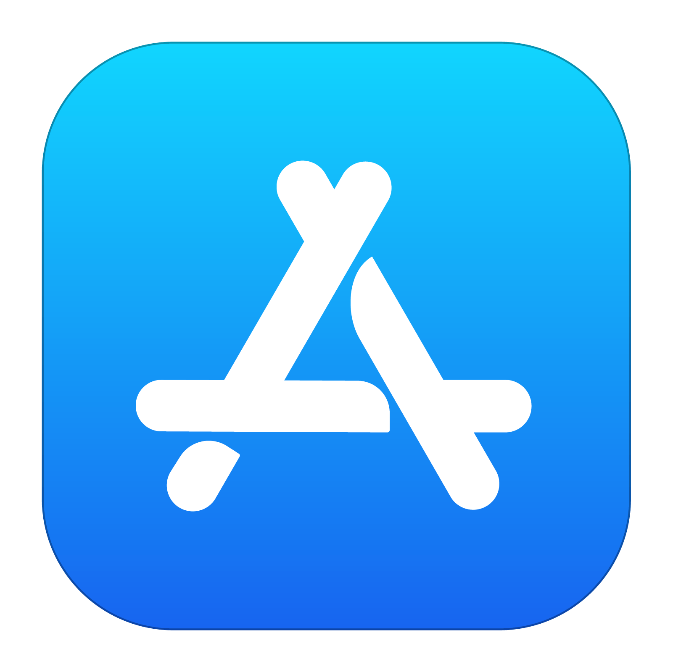
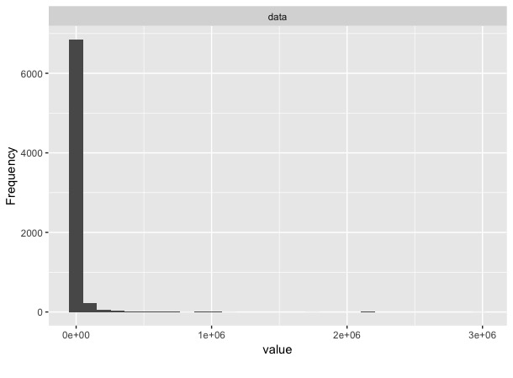
Train Dataset: Total Ratings count summary
Min | 1st Q | Median | Mean | 3rd Q | Max
0 | 23.5 | 278 | 11970.5 | 2550 | 2974676
With no download count, the total number of ratings are considered to be the number of downloads
Ratings are heavily skewed right

Slide 9
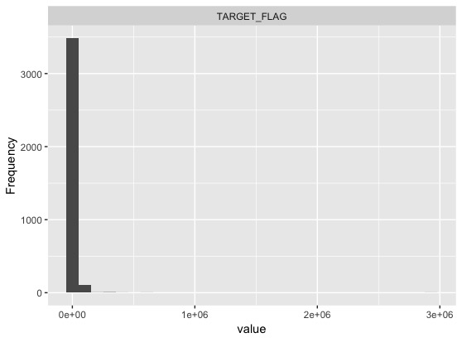
Poisson model summary
Min | 1st Q | Median | Mean | 3rd Q | Max
0 | 51.3 | 1414.2 | 14288.4 | 24033.1 | 2929384.5
Poisson regression is often used for modeling count data
Poisson results are heavily skewed right
1st Q and median are higher than the ratings summary but the rest of the results mirror that of the train’s dataset

Slide 10
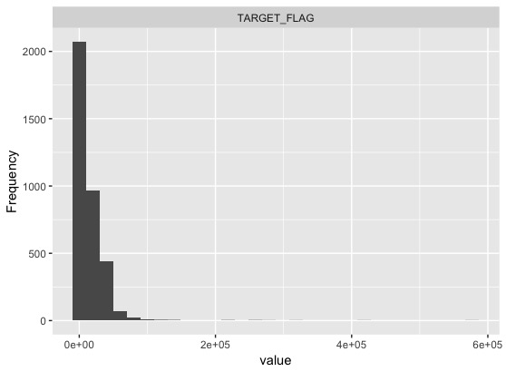
Zero inflated model summary
Min | 1st Q | Median | Mean | 3rd Q | Max
0 | 48.4 | 1379.9 | 13470.6 | 24029.8 | 577129.3
Zero inflated Poisson regression is used to model count data that has an excess amount of zeroes
Zero inflated results are less skewed than Poisson’s and train’s
Max result is significantly lower than the max from the train’s dataset

Slide 11
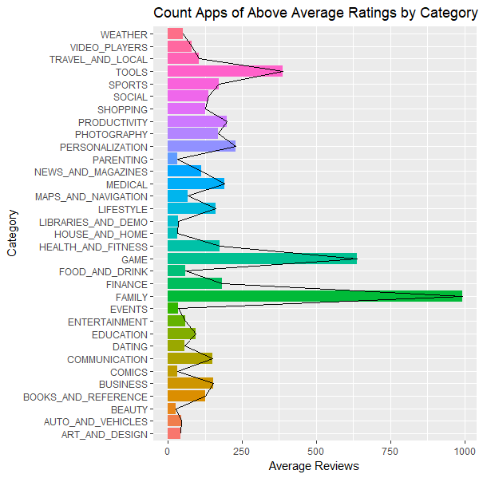
Train Dataset: above or below average rating
In the Google app store analysis, success was considered if an app had above the average rating.
Total Install and reviews in data set was highly skewed
Goal is to predict if App had higher than average rating score.

Slide 12
Quasi model summary
Min | 1st Q | Median | Mean | 3rd Q | Max
.1172 | .49 | .60 | .63 | .74 | 1.5
Using the Quasi Model, we had an accuracy of 67%
The model was able to predict 53% of the apps that are above average
Model not sufficient enough for predicting bad apps (10%)

Slide 13
Quasi model summary
Min | 1st Q | Median | Mean | 3rd Q | Max
-095 | .503 | .626 | .629 | .756 | 1.22
Using the Quasi Model, we had an accuracy of 67%
The model was able to predict 52% of the apps that are above average
Model not sufficient enough for predicting bad apps (11%)

Slide 14
Binomial model summary
Min | 1st Q | Median | Mean | 3rd Q | Max
0 | .49 | .64 | .69 | .77 | .97
Using the Binomial Model we had an accuracy of 67%
The model was able to predict 53% of the apps that are above average
Model not sufficient enough for predicting bad apps (15%)

